Slide 1
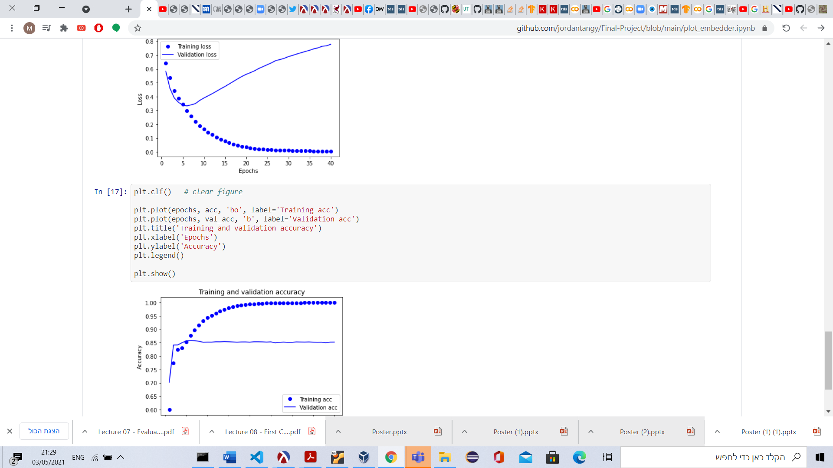
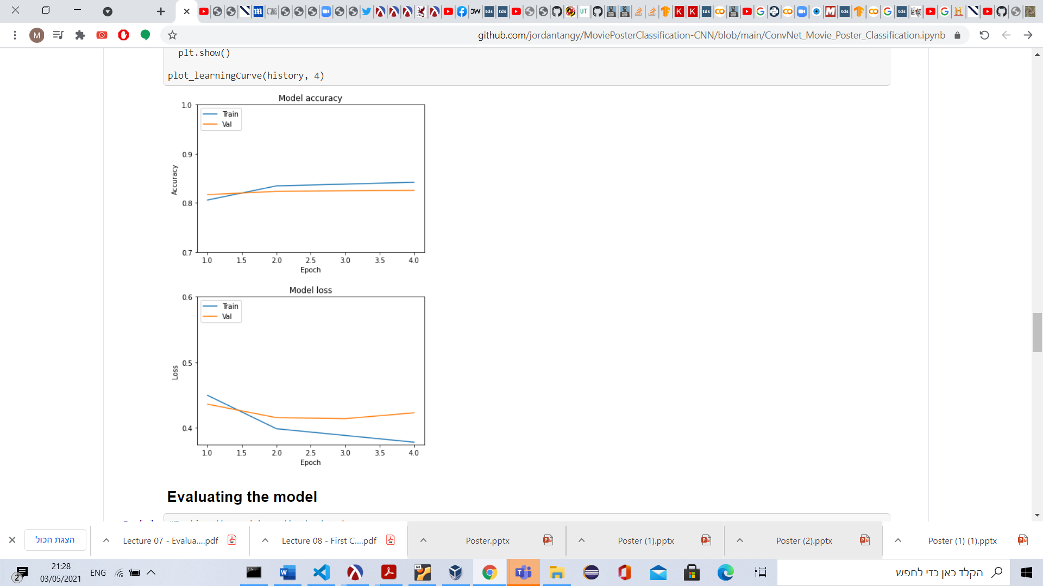
Instructed by Weiss Roi
Jordan Tangy(336208657), Max Krakauer(302256102), Ron Sider(316281047)
Genre Prediction
Project goals
Our project aims at improving movie genre prediction by using two different data sets. The main goal is to build a CNN model that will take as input movie posters and given a new poster, the model will be able to predict the corresponding genre. In addition, we wanted to maximum our results, thus we added another model which also predicts movie genre but according to movie plots (for each poster in the previous dataset accordingly). Finally we want to optimize the results and find out whether two dataset and two models can improve our results.
Methods
Web scraping movie plots from IMDB
Building two deep learning models(first is CNN and second is Encoder) that use a movie’s posters and plot, respectively, to predict the movie’s genre
Inserting the movie plot and poster into the respective deep learning models
**Building a model that combines the previous models results and emits the best results.
**Using tensorflow and other python libraries in order to process the data and get the best results
Selected tools and algorithms
Tools and Technologies :Python, Google Collab, Microsoft Office Tools.
Deep Learning: Convolutional Neural Networks, Google Encoder, TensorFlow, Keras, Pytorch
Web Scrapper : Selenium, Beautiful Soup
Storage : GitHub, Excel, Google Drive
Results
:
Github Link:
https://github.com/jordantangy/Final-Project

